Slide 1
Intro to the Virtual School Pilot, HTC, and OSG
Monday, July 13
Tim Cartwright, Lauren Michael

Slide 2
Welcome to the OSG Virtual School Pilot 2020!

Slide 3
Why You Are Here
You need large-scale, HTC-style computing – or support researchers who do
Do not let computing block your research!
Computing is cheap and plentiful
Push the limits of what you can do
If you run out of science to do, transcend the boundaries of your science
When computing becomes a barrier, push us to fix the problems
Help & encourage others: In your lab, in your department, in your field, friends, etc.

Slide 4
Goals
Help you learn the basics of HTC quickly
Reach your own objectives!

Slide 5
Format
Lectures: Tue, Wed, Thu + Tue – 11 am · 3 pm CT
Showcase (2nd Wed): science transformed by HTC
Bonus topics (2nd Wed): optional, mentor can help pick
Work times: Most days – strongly encouraged, if you can
Consultations: Meet one-on-one with your mentor
Lightning talks (2nd Fri): optional, chance to show work

Slide 6
Mentor
Your primary point of contact But you will work with others, too!
Will help set goals, monitor progress, find resources/solutions, etc.
When in doubt, contact your mentor (or Tim or Lauren or any staff member)

Slide 7
Communication Tools
Blackboard Collaborate Lectures, Work times when needed, Showcase
Slack All the time! #general, topics, DMs
Zoom (or other) Scheduled for one-on-one meetings or small groups
Website Slides, exercises, lectures (eventually), schedule, etc.

Slide 8
Feedback Is Vital
Tell us what we could do better
Any time, any staff member, any reason, …
Planning on 2 evaluation surveys
We are here for you!!!

Slide 9
Intro to HTC and OSG

Slide 10
Overview
What is high throughput computing (HTC) ?
What is the Open Science Grid (OSG)?
How do you get the most out of the above?

Slide 11

HTC: An Analogy

Slide 12


HTC: An Analogy

Slide 13
Serial Computing
What many
programs look like:
time
Serial execution, running one task at a time
Overall compute time grows significantly as individual tasks get more complicated (long) or if the number of tasks increases
How can you speed things up?

Slide 14
High Throughput Computing (HTC)
Parallelize!
Independent tasks run on different cores
n cores
time

Slide 15
High Performance Computing (HPC)
n cores
Benefits greatly from:
CPU speed + homogeneity
shared filesystems
fast, expensive networking (e.g. Infiniband) and servers co-located
Requires special programming (MP/MPI)
Scheduling: Must wait until all processors are available, at the same time and for the full duration
What happens if one core or server fails or runs slower than the others?
…
time
…
…

Slide 16
High Throughput Computing (HTC)
n cores
time
Scheduling: only need 1 CPU core for each (shorter wait)
Easier recovery from failure
No special programming required
Number of concurrently running jobs is more important
CPU speed and homogeneity are less important

Slide 17
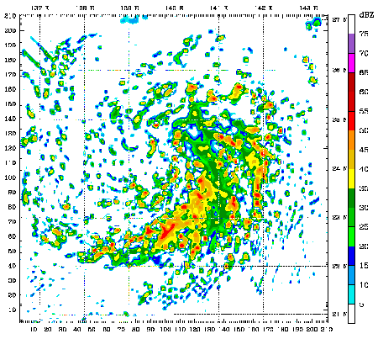
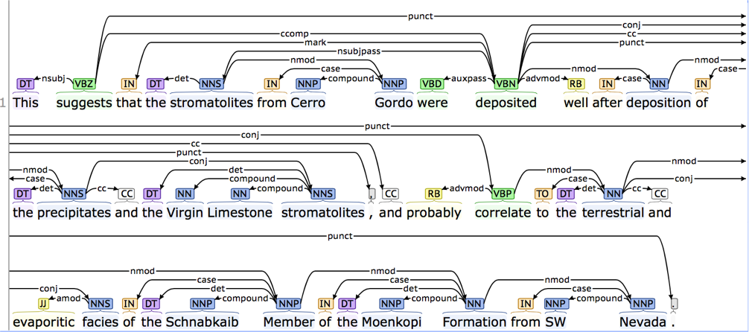
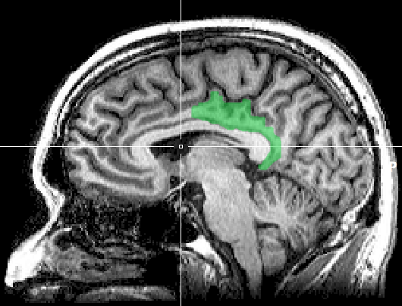
HTC Examples
text analysis (most genomics …)
multi-start simulations
parameter sweeps
statistical model optimization
(MCMC, numerical methods, etc.)
multi-image and
multi-sample analysis

Slide 18
Example Challenge
You need to process 48 brain images for each of 168 patients. Each image takes ~1 hour of compute time.
168 patients x 48 images = ~8000 tasks = ~8000 hrs
Conference is next week.

Slide 19
Distributed Computing
Use many computers, each running one instance of our program
Example:
1 laptop (1 core) => 8,000 hours = ~1 year
1 server (~40 cores) => 500 hours = ~1.5 weeks
1 large job (400 cores) => 20 hours = ~1 day
A whole cluster (8,000 cores) = ~1 hour

Slide 20
Signs of HTC-able work
Any mention of numerous samples, images, models, parameters, etc.
Nearly anything written by the primary user (e.g. c/fortran, Python, R)
Break out of loops!
Common internal parallelism could really be HTC (e.g. Matlab’s ‘parfor’, ‘distributed server’, etc.)
Some community softwares that use multi-threading or multiprocessing (e.g. OpenMP)
many are simply looping over data portions or independent tasks
HTC-able: break up input (or ‘parameter’ space), turn off multi-threading, combine results
Long-running jobs (especially if non-MPI); see above explanations

Slide 21
What computing resources are available?
A single computer?
A local cluster?
Consider: What kind of cluster is it? Typical clusters tuned for HPC (large MPI) jobs may not be best for HTC workflows! Do you need even more than that?
Open Science Grid (OSG)
Other
European Grid Infrastructure
Other national and regional grids
Commercial cloud systems (e.g. HTCondor on Amazon)

Slide 22

Example Local Cluster
UW-Madison’s Center for High Throughput Computing (CHTC)
Recent CPU hours:
~120 million hrs/year (~15k cores)
Up to 15,000 per user, per day
(~600 cores in use)
CHTC Pool
single-core
high-memory
multi-core
MPI
GPUs
submit server

Slide 23
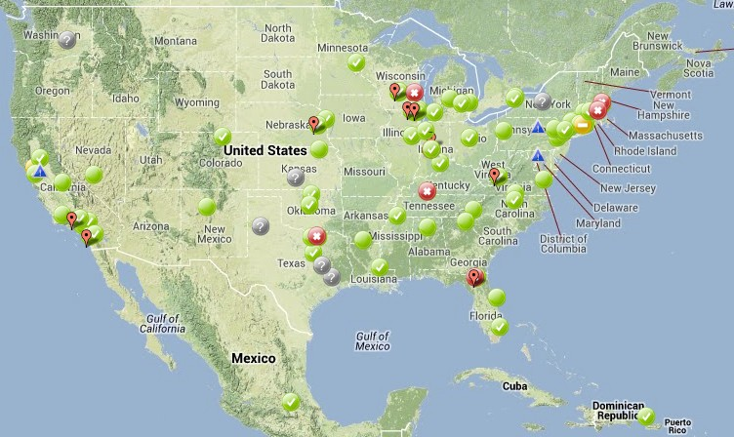
Open Science Grid
(d)HTC for Everyone
~100 contributors
Past year:
>1.6 billion CPU hours
>200 petabytes transferred
Can submit jobs locally, they backfill across the country - interrupted at any time (but not too frequent)
https://www.opensciencegrid.org/

Slide 24
Is it OSG-able?

Slide 25
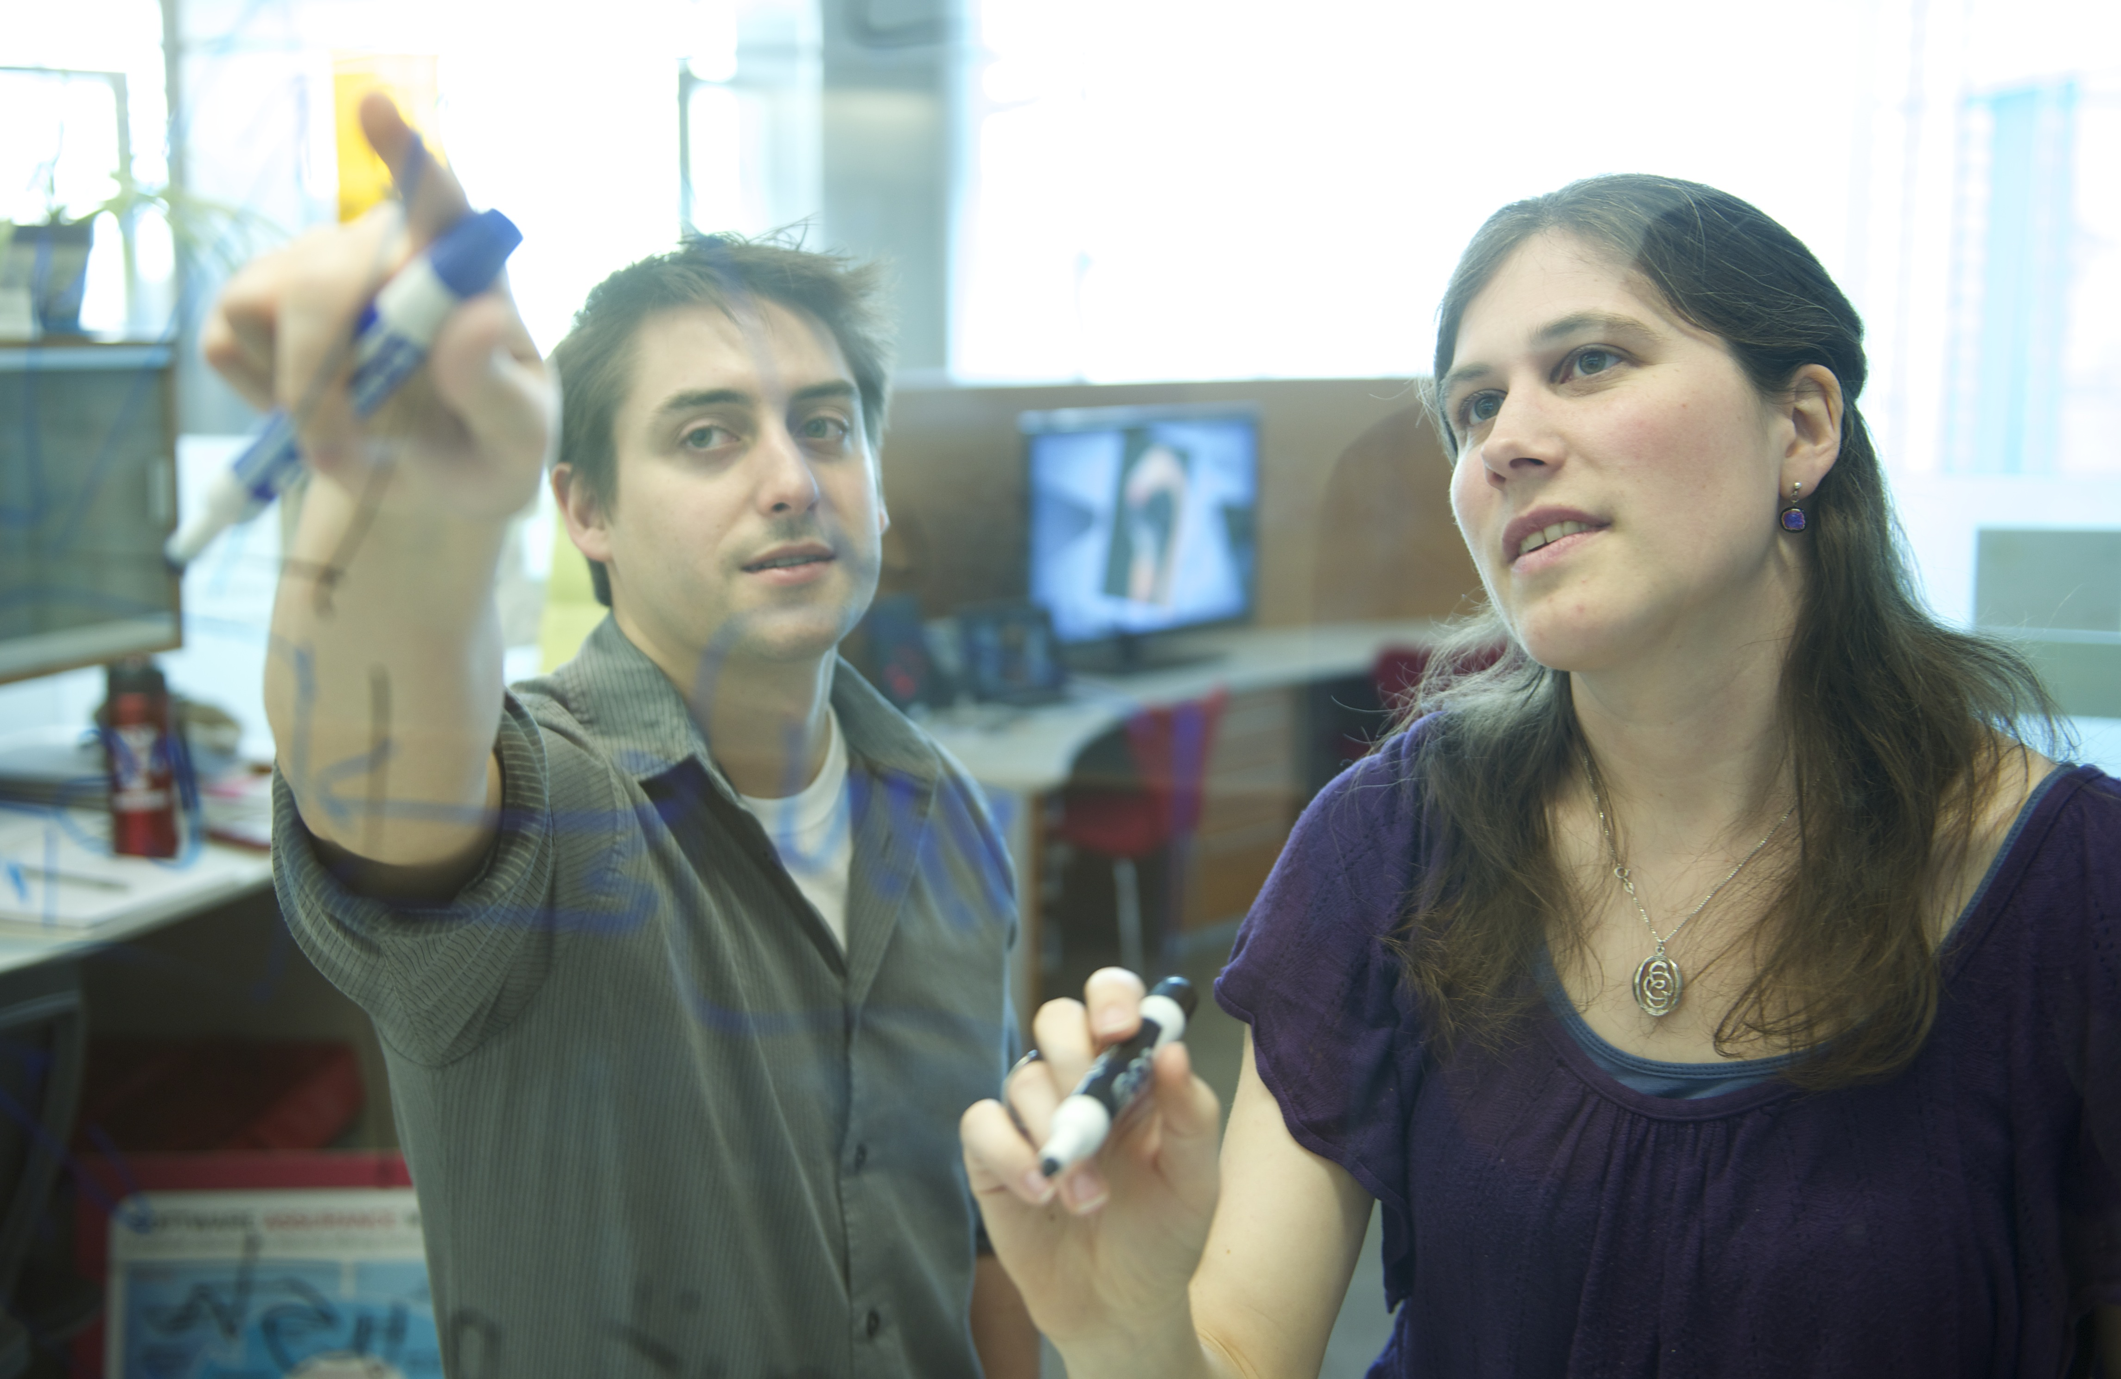
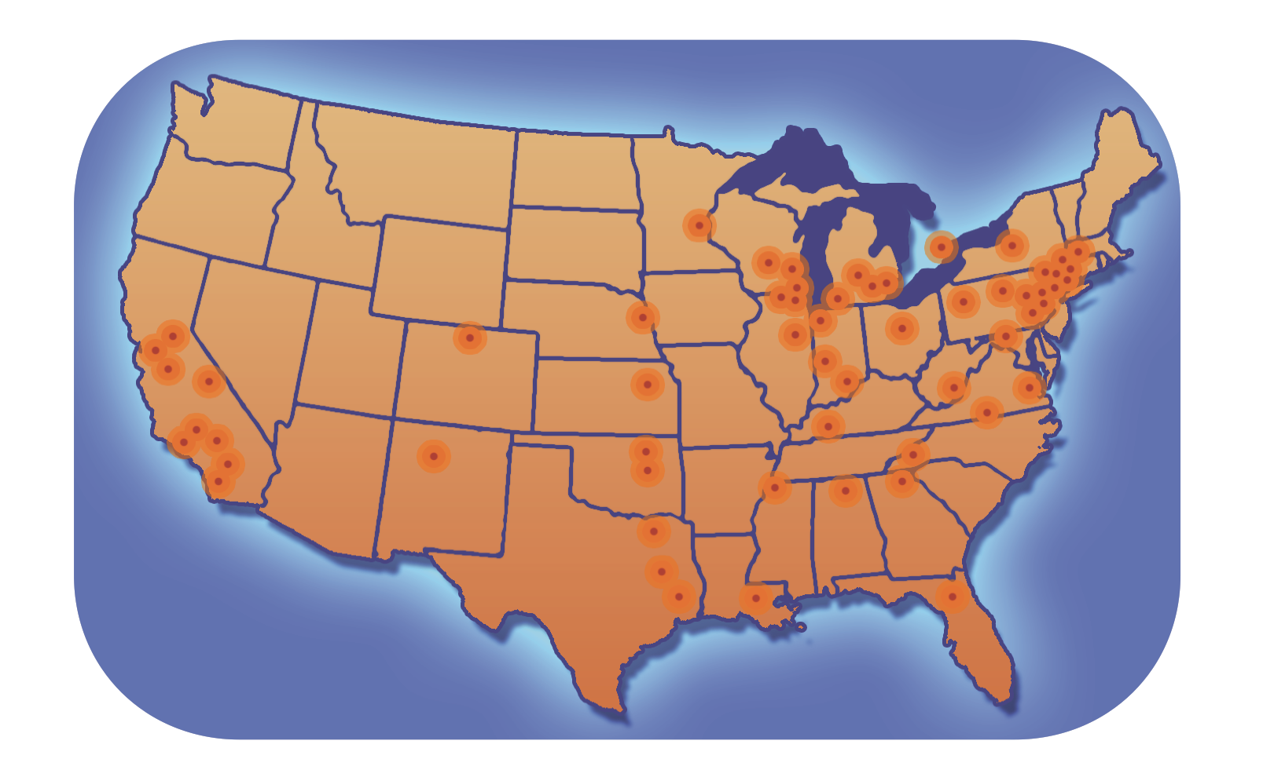
For Researchers and Campuses
Proactive, personalized facilitation and support for:
Individual researchers via OSG Connect
Institutions and large collaborations
Share local resources via OSG
Locally-supported submit points
data and identity federation
integration of cloud capacity
Local HTC Capacity
Learn from OSG’s Research Computing Facilitators
Presentations/Training in OSG compute execution, HTC Facilitation, and local HTC systems administration

